Slide 1



STOPY, STROMY, ROSTLINY
TEST

Slide 2
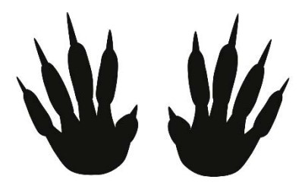
1

Slide 3
2

Slide 4

3

Slide 5

4

Slide 6
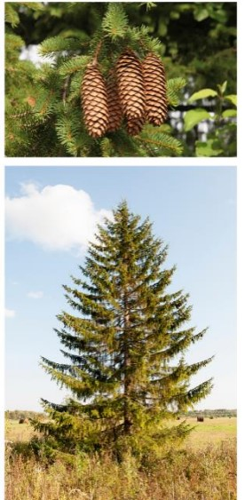
5

Slide 7

6

Slide 8
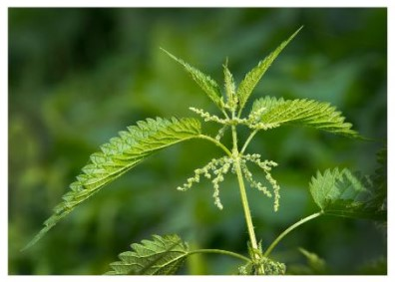
7

Slide 9

8

Slide 10
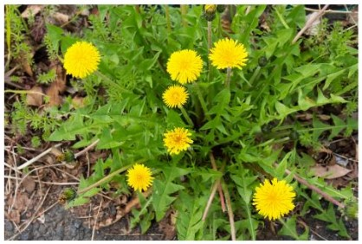
9

Slide 11

10

Slide 12

11

Slide 13

12

Slide 14
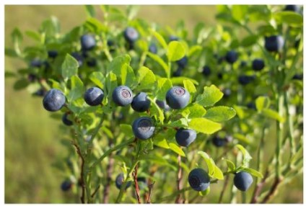
13

Slide 15

14

Slide 16
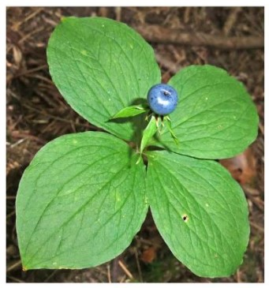
15

Slide 17

16

Slide 18

17

Slide 19

18

Slide 20
19

Slide 21

20

Slide 22

21

Slide 23

22

Slide 24

23

Slide 25

24

